Slide 1
Linux
Bypassing Login Page
James Soko

Slide 2
Parrot OS
01

Slide 3
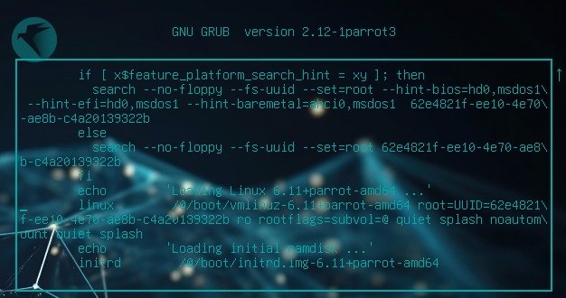
EDIT MODE
Restart your machine and press Esc or Shift during reboot.
Press E on your keyword.

Slide 4
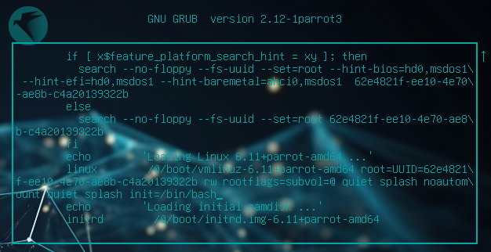
EDIT MODE
Change ro to rw (Read and Write) and add init=/bin/bash or single at the end

Slide 5
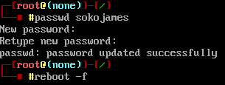
CHANGE USER PASSWORD
Press Ctrl + X or F10 to boot.
Press Enter

